Slide 1


A snapshot of Overseas Migration and Property Prices in Australia
June 2013 - December 2021
Group 2
Fabiano Santos
Lewis Trenerry
Liwei Jiang
Simone Nagel
12 February 2024

Slide 2






Slide 3

Research Questions
What were the states/territories most and least impacted by overseas migration between in the last 10 years?
What were the capital cities most and least impacted by the rise in property prices in that same period?
Is there any correlation between overseas migration and property prices?

Slide 4


Data Cleansing
CSV files
Net overseas migration- larger states
Net overseas migration- smaller states and territories
Residential Property Price Indexes, capital cities
Actions taken
Merge the migration data ‘pd.merge’
Remove rows without data ‘drop.na’
Manipulate Quarter data for desired timeframe
‘str.match’ to remove non-date value
‘pd.to_datetime’ and update of format (to enable filtering by dates)
‘dt.strftime’ to convert back to text quarter for cleaner visualisation
Quarterly relative change added to data frame ‘pct_change’ function

Slide 5
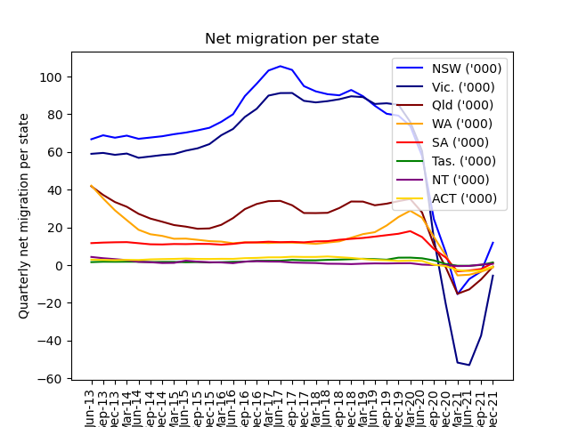
What were the states/territories most and least impacted by overseas migration between in the last 10 years?

Slide 6
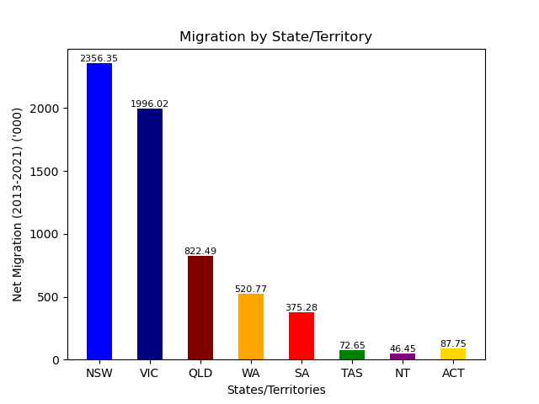
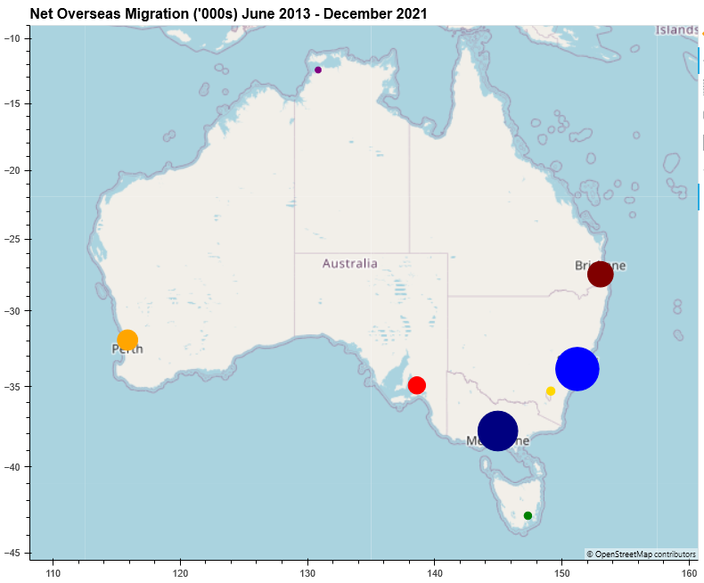

Slide 7
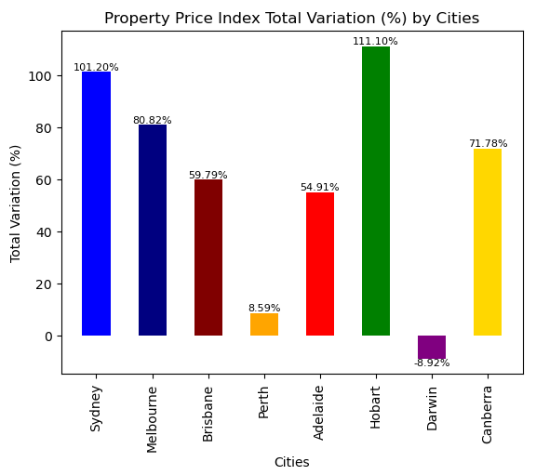
What were the capital cities most and least impacted by the rise in property prices in that same period?

Slide 8
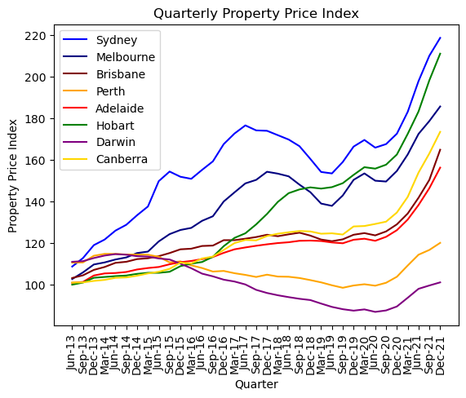

Slide 9
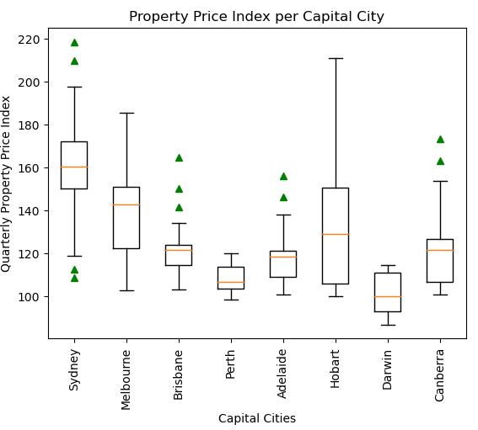

Slide 10

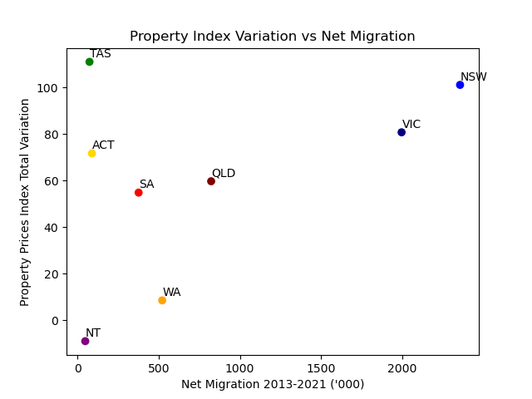
Is there any correlation between overseas migration and property prices?

Slide 11
States | Correlation
NSW | -0.50
VIC | -0.45
QLD | -0.74
WA | -0.43
SA | -0.87
TAS | -0.49
NT | -0.33
ACT | -0.78

Slide 12
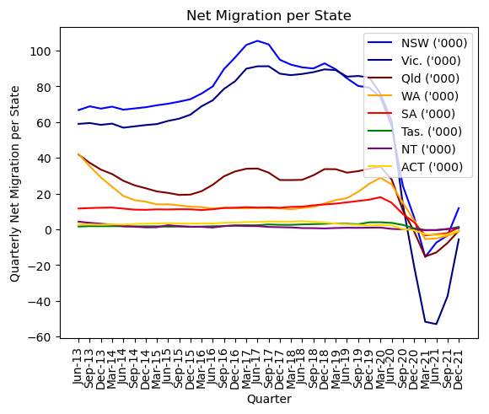
Covid-19

Slide 13
States | Correlation | W/O COVID
NSW | -0.50 | -0.43
VIC | -0.45 | -0.25
QLD | -0.74 | -0.13
WA | -0.43 | 0.54
SA | -0.87 | -0.29
TAS | -0.49 | 0.23
NT | -0.33 | 0.49
ACT | -0.78 | 0.09

Slide 14
